Slide 1
Grover’s Algorithm
Quantum search algorithm
不正经讲师：理科宅Hunt

Slide 2

Classical search algorithm
Problem: Given $f:{\left\{0,1\right\}}^{n}→\{0,1\}$, we want to find a bit string $w∈{\left\{0,1\right\}}^{n}$ such that $f\left(w\right)=1$. The existence of $w$ is guaranteed.
Classical algo: The sequence of input has length $N=2^{n}$, we loop through this sequence and calculate $f$ one by one until we find $w$.
The time complexity of classical algorithm is $O(N)$.
In quantum computing, Grover’s algorithm provides quadratic speed up! Which is $O\left(\sqrt{N}\right)$.

Slide 3
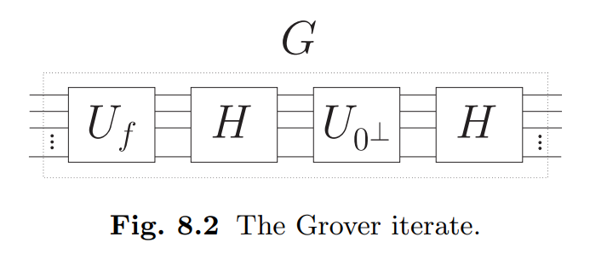
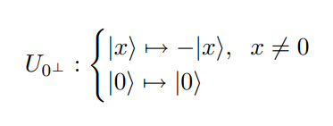

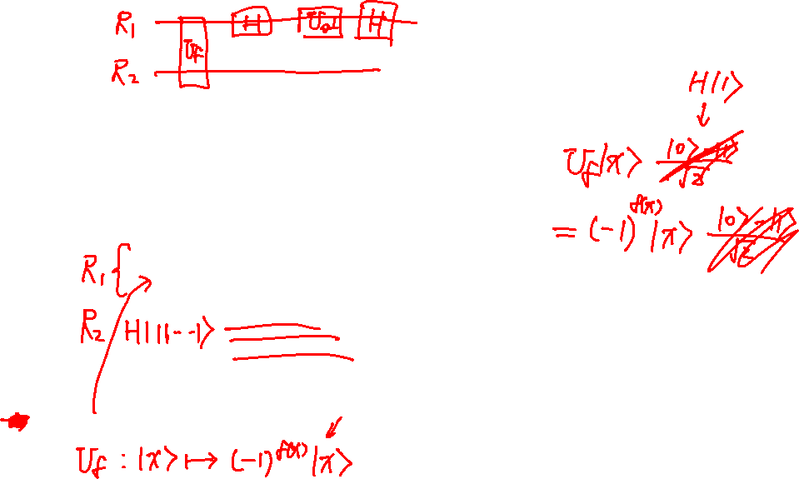
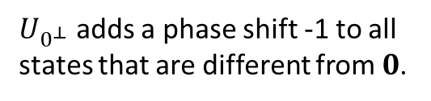
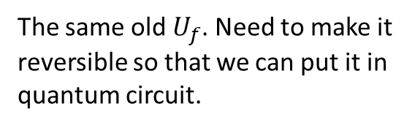
Grover’s iterate
The same old $U_{f}$. Need to make it reversible so that we can put it in quantum circuit.
$U_{0^{⊥}}$ adds a phase shift -1 to all states that are different from $0$.

Slide 4
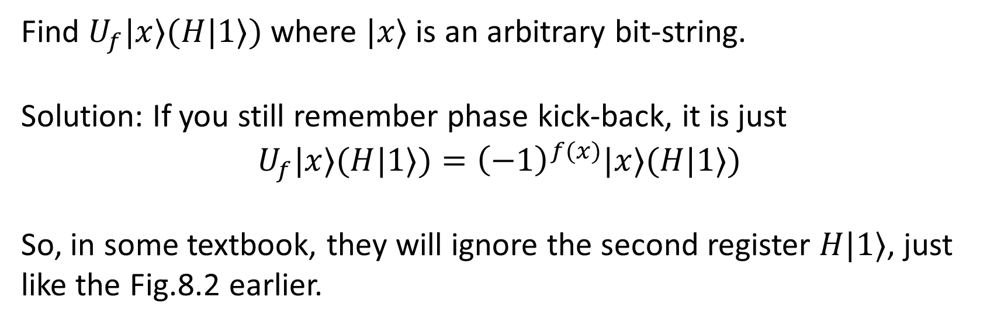
Exercise – Phase kick-back revisit
Find $U_{f}|x⟩(H|1⟩)$ where $|x⟩$ is an arbitrary bit-string.
Solution: If you still remember phase kick-back, it is just
$$U_{f}|x⟩(H|1⟩)={\left(−1\right)}^{f(x)}|x⟩(H|1⟩)$$
So, in some textbook, they will ignore the second register $H|1⟩$, just like the Fig.8.2 earlier.

Slide 5
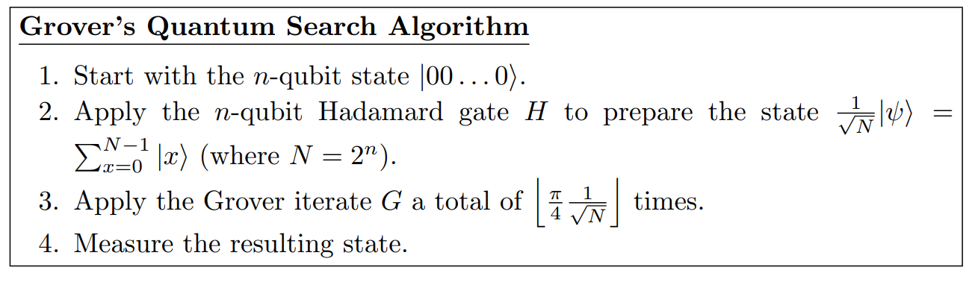
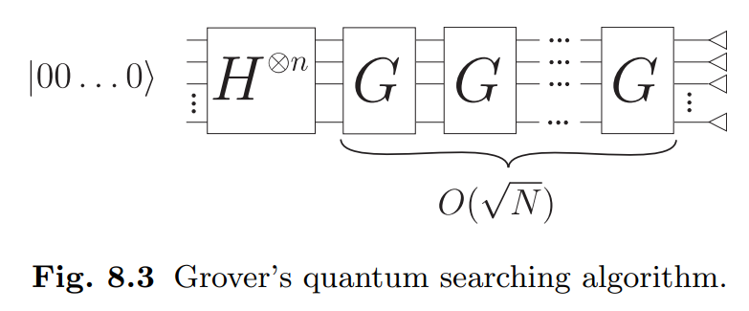

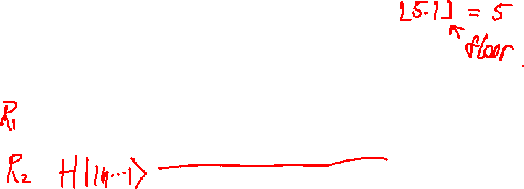
Grover’s Algorithm

Slide 6

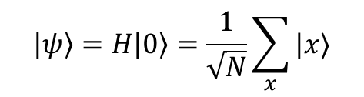



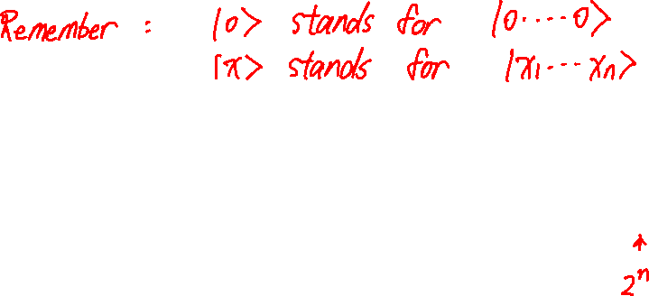
Example – Step 1 and 2 (Prepare states)
$$\left|ψ\right\rangle$$
$$\left|ψ_{1}\right\rangle$$
$$\left|ψ_{2}\right\rangle$$
$$\left|ψ_{k}\right\rangle$$
$$\left|ψ\right\rangle =H\left|0\right\rangle =\frac{1}{\sqrt{N}}\sum_{x}{|x⟩}$$

Slide 7

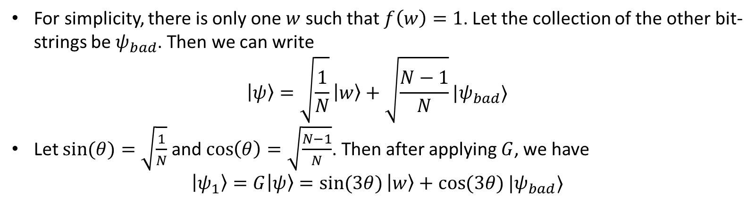




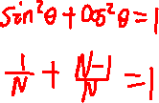
Example – Step 3 (first iteration)
For simplicity, there is only one $w$ such that $f\left(w\right)=1$. Let the collection of the other bit-strings be $ψ_{bad}$. Then we can write
$$\left|ψ\right\rangle =\sqrt{\frac{1}{N}}\left|w\right\rangle +\sqrt{\frac{N−1}{N}}|ψ_{bad}⟩$$
Let $\sin{(θ)}=\sqrt{\frac{1}{N}}$ and $\cos\left(θ\right)=\sqrt{\frac{N−1}{N}}$. Then after applying $G$, we have
$$\left|ψ_{1}\right\rangle =G\left|ψ\right\rangle =\sin{(3θ)}\left|w\right\rangle +\cos{(3θ)}|ψ_{bad}⟩$$
$$\left|ψ\right\rangle$$
$$\left|ψ_{1}\right\rangle$$
$$\left|ψ_{2}\right\rangle$$
$$\left|ψ_{k}\right\rangle$$

Slide 8

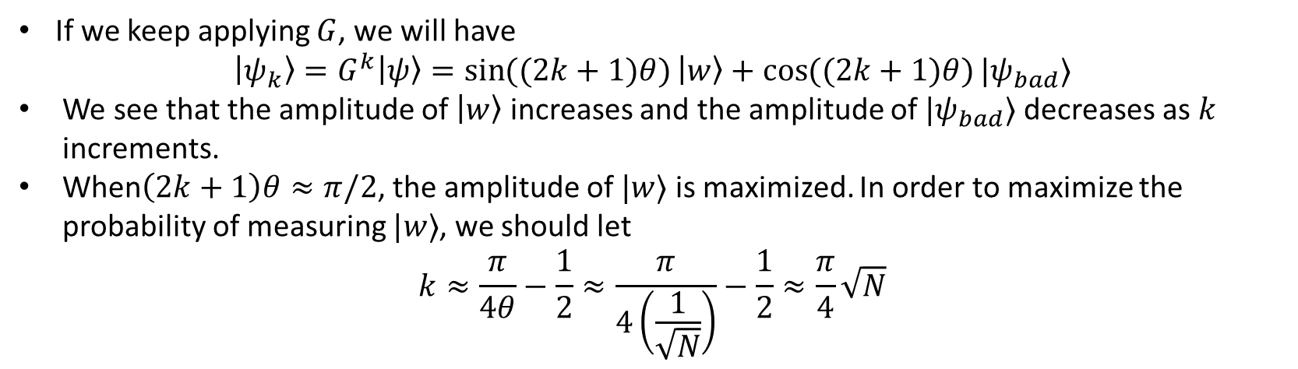

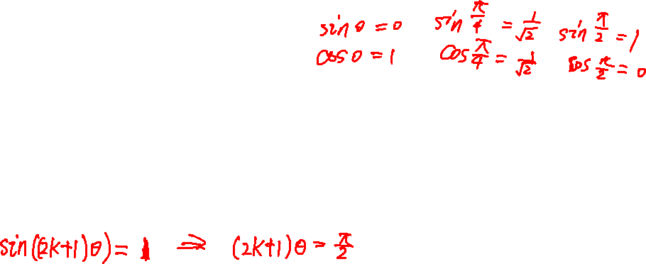


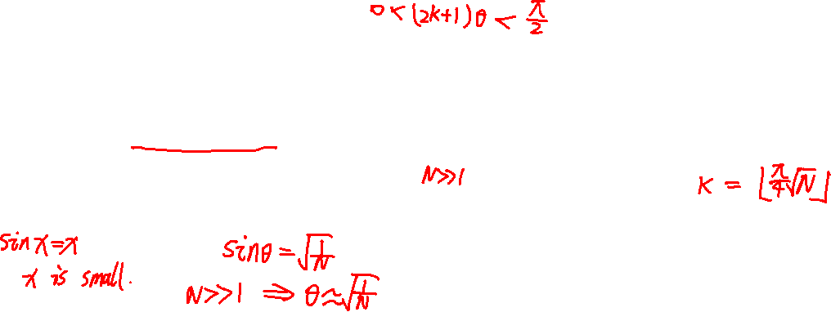
Example – Step 3 (k-th iteration)
If we keep applying $G$, we will have
$$\left|ψ_{k}\right\rangle =G^{k}\left|ψ\right\rangle =\sin{((2k+1)θ)}\left|w\right\rangle +\cos{((2k+1)θ)}|ψ_{bad}⟩$$
We see that the amplitude of $\left|w\right\rangle$ increases and the amplitude of $|ψ_{bad}⟩$ decreases as $k$ increments.
When$\left(2k+1\right)θ≈π/2$, the amplitude of $|w⟩$ is maximized. In order to maximize the probability of measuring $|w⟩$, we should let
$$k≈\frac{π}{4θ}−\frac{1}{2}≈\frac{π}{4\left(\frac{1}{\sqrt{N}}\right)}−\frac{1}{2}≈\frac{π}{4}\sqrt{N}$$
$$\left|ψ\right\rangle$$
$$\left|ψ_{1}\right\rangle$$
$$\left|ψ_{2}\right\rangle$$
$$\left|ψ_{k}\right\rangle$$

Slide 9

Summary
Classical search algorithm has time complexity $O(N)$ for a sequence of length $N$.
Grover’s algorithm has time complexity $O\left(\sqrt{N}\right)$ for a sequence of length $N$, quadratic speed up.
Grover’s algorithm utilizes the amplification of probability amplitudes.

